Slide 1
Last Moment Train Ticket booking and cancelling Project
By- Ishita Agarwal

Slide 2
Problem Statement
Many people face problems while booking tickets as seats are full and some want to cancel their tickets at last moment.They are not able to do so due to not having a proper application.

Slide 3
Solution/Idea
We will build a web application where those who want tickets can fill their information and those who want to cancel will fill their information and their ticket will be cancelled if someone wants a ticket of same train with full refund and a mail will be sent to the person who is in need of ticket and top of database(filled data first) that seat is available.

Slide 4
Architectural Plan
Using HTML and CSS
Using PHP and Mysql
A simple website is built
Store data or search in database
It will take data from users(both who want to cancel and book tickets)..
If user wants to book ticket, data will be stored and if he or she wants to cancel, train no will be searched and info will be provided if anyone wants to book ticket.

Slide 5
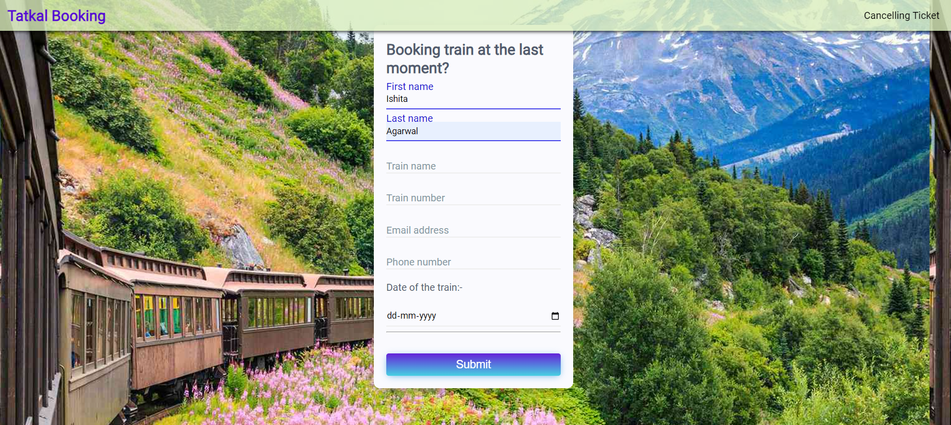
WebsiteBooking.html

Slide 6
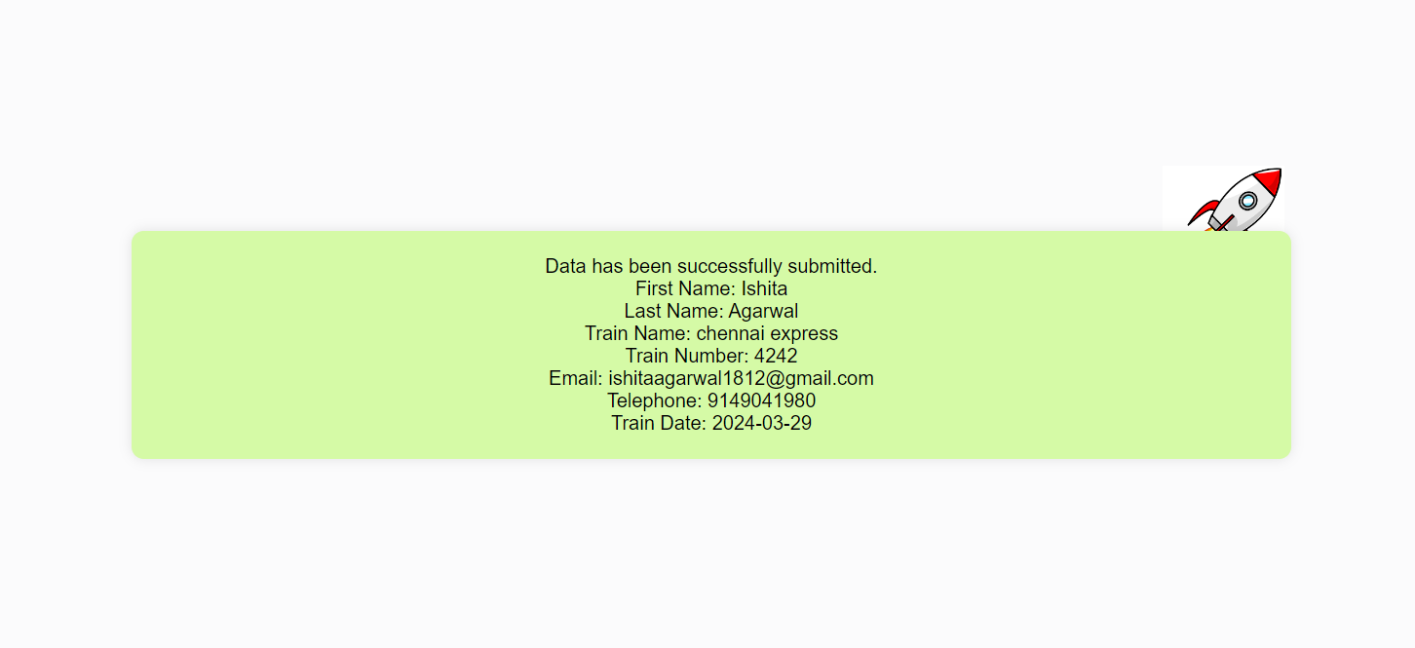
PassBooking.html

Slide 7
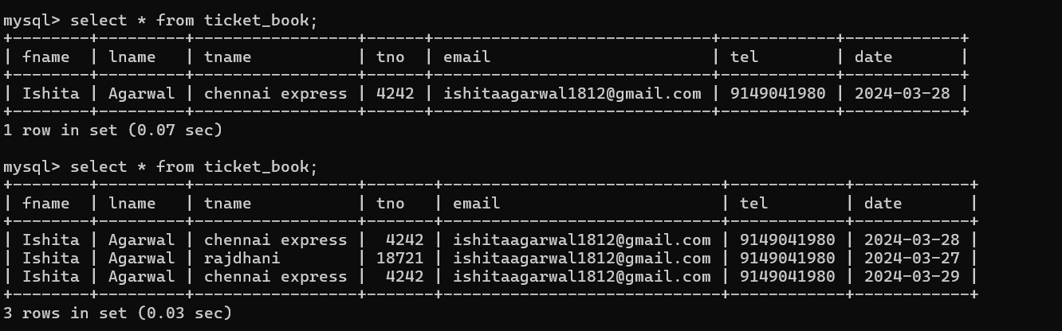
Mysql table

Slide 8
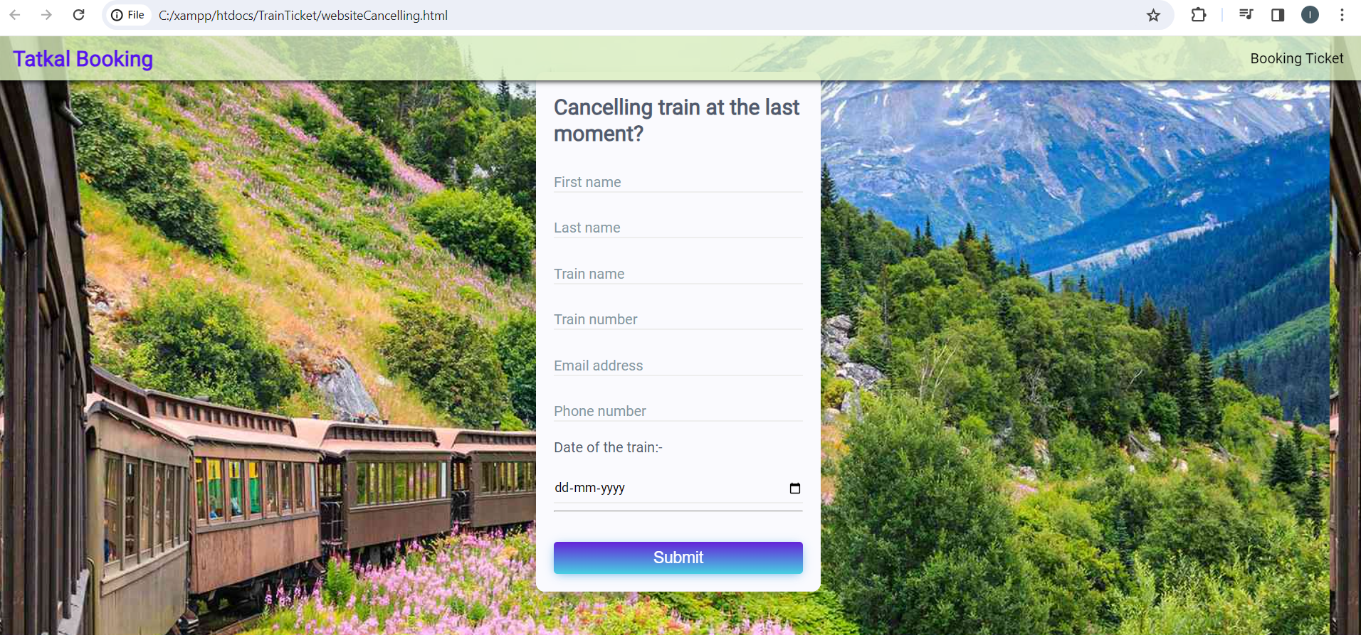
WebsiteCancelling.html

Slide 9
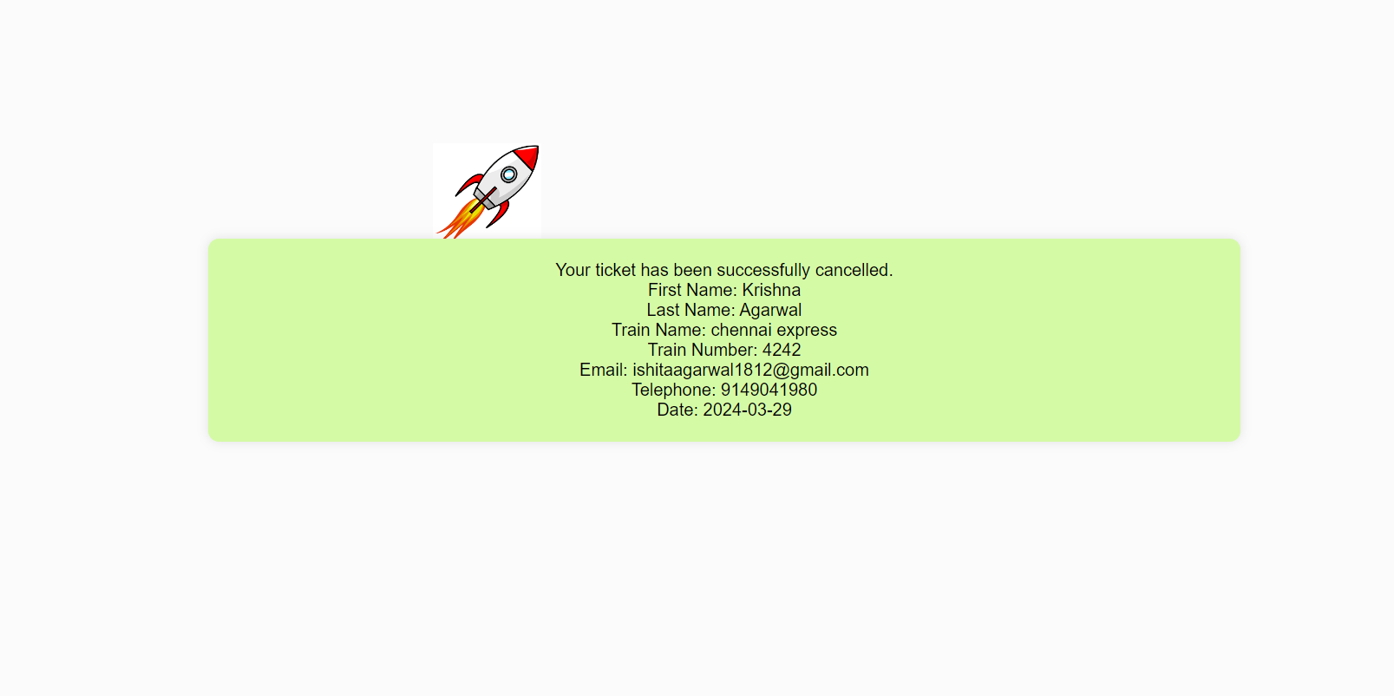
PassCancelling.html

Slide 10
THANK YOU

